Slide 1
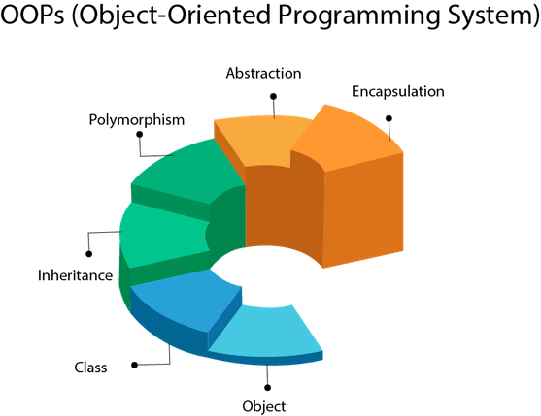
Object-Oriented Programming is a methodology or paradigm to design a program using classes and objects.
It simplifies software development and maintenance by providing some concepts

Slide 2
What Is an Object?
Real-world objects share two characteristics: They all have state and behavior.
Dogs have state (name, color, breed, hungry) and behavior (barking, fetching, wagging tail).
Bicycles also have state (current gear, current pedal cadence, current speed) and behavior (changing gear, changing pedal cadence, applying brakes).
Identifying the state and behavior for real-world objects is a great way to begin thinking in terms of object-oriented programming.
Software objects are conceptually similar to real-world objects: they too consist of state and related behavior.
An object stores its state in fields (variables in some programming languages) and exposes its behavior through methods (functions in some programming languages).
Methods operate on an object's internal state and serve as the primary mechanism for object-to-object communication.
Hiding internal state and requiring all interaction to be performed through an object's methods is known as data encapsulation — a fundamental principle of object-oriented programming.

Slide 3
Bundling code into individual software objects provides a number of benefits, including:
Modularity: The source code for an object can be written and maintained independently of the source code for other objects. Once created, an object can be easily passed around inside the system.
Information-hiding: By interacting only with an object's methods, the details of its internal implementation remain hidden from the outside world.
Code re-use: If an object already exists (perhaps written by another software developer), you can use that object in your program.
This allows specialists to implement/test/debug complex, task-specific objects, which you can then trust to run in your own code.
Pluggability and debugging ease: If a particular object turns out to be problematic, you can simply remove it from your application and plug in a different object as its replacement.
This is analogous to fixing mechanical problems in the real world. If a bolt breaks, you replace it, not the entire machine.

Slide 4
In Java, a class encapsulates the fields, which hold the state of an object, and the methods, which define the actions of the object.
Encapsulation enables you to write reusable programs.
It also enables you to restrict access only to those features of an object that are declared public.
All other fields and methods are private and can be used for internal object processing.

Slide 5
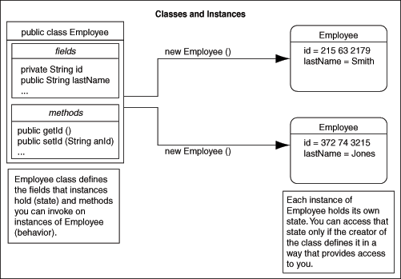

Slide 6
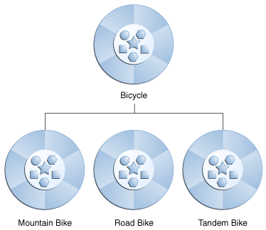
What Is Inheritance?
Object-oriented programming allows classes to inherit commonly used state and behavior from other classes.
It enables classes to include properties of other classes.
The class that inherits the properties is called a child class or subclass, and the class from which the properties are inherited is called a parent class or superclass.
This feature also helps in reusing already defined code.
In this example, Bicycle now becomes the superclass of MountainBike, RoadBike, and TandemBike.
In the Java programming language, each class is allowed to have one direct superclass, and each superclass has the potential for an unlimited number of subclasses:
class MountainBike extends Bicycle {
// new fields and methods defining
// a mountain bike would go here
}

Slide 7
Polymorphism
If one task is performed in different ways, it is known as polymorphism.
For example: to convince the customer differently, to draw something, for example, shape, triangle, rectangle, etc.
In Java, we use method overloading and method overriding to achieve polymorphism.
Polymorphism is the ability for different objects to respond differently to the same message.
In object-oriented programming languages, you can define one or more methods with the same name.
These methods can perform different actions and return different values.

Slide 8
Interfaces
Java supports only single inheritance, that is, each class can inherit fields and methods of only one class.
If you need to inherit properties from more than one source, then Java provides the concept of interfaces, which is a form of multiple inheritance.
Interfaces are similar to classes. However, they define only the signature of the methods and not their implementations.
The methods that are declared in the interface are implemented in the classes.
Multiple inheritance occurs when a class implements multiple interfaces.

Slide 9
Automatic storage management
A JVM automatically performs all memory allocation and deallocation while the program is running.
Java programmers cannot explicitly allocate memory for new objects or free memory for objects that are no longer referenced.
Instead, they depend on a JVM to perform these operations.
The process of freeing memory is known as garbage collection.

Slide 10
Strong typing
Before you use a field, you must declare the type of the field.
Strong typing in Java makes it possible to provide a reasonable and safe solution to interlanguage calls between Java and PL/SQL applications, and to integrate Java and SQL calls within the same application.

Slide 11
Flexible namespace
Java defines classes and places them within a hierarchical structure that mirrors the domain namespace of the Internet.
You can distribute Java applications and avoid name collisions.
Java extensions, such as the Java Naming and Directory Interface (JNDI), provide a framework for multiple name services to be federated.
The namespace approach of Java is flexible enough for Oracle to incorporate the concept of a schema for resolving class names in full compliance with the JLS.

Slide 12
Encapsulation in Java
Encapsulation in Java is a process of wrapping code and data together into a single unit, for example, a capsule which is mixed of several medicines.
Wrapping up data member and function into single unit.
Data member=properties/states.
Function=methods/ behavior.
We can create a fully encapsulated class in Java by making all the data members of the class private. Now we can use setter and getter methods to set and get the data in it.
The Java Bean class is the example of a fully encapsulated class.
Advantage of Encapsulation in Java
By providing only a setter or getter method, you can make the class read-only or write-only. In other words, you can skip the getter or setter methods.

Slide 13
Example
package com.javatpoint;
public class Student{
private String name;
public String getName(){
return name;
}
public void setName(String name){
this.name=name
}
}
Sc.setName(“tushar”);
SOUT(sc.getName());

Slide 14
